Slide 1
War of 1812
Everything You Need To Know For Your APUSH Exam

Slide 2
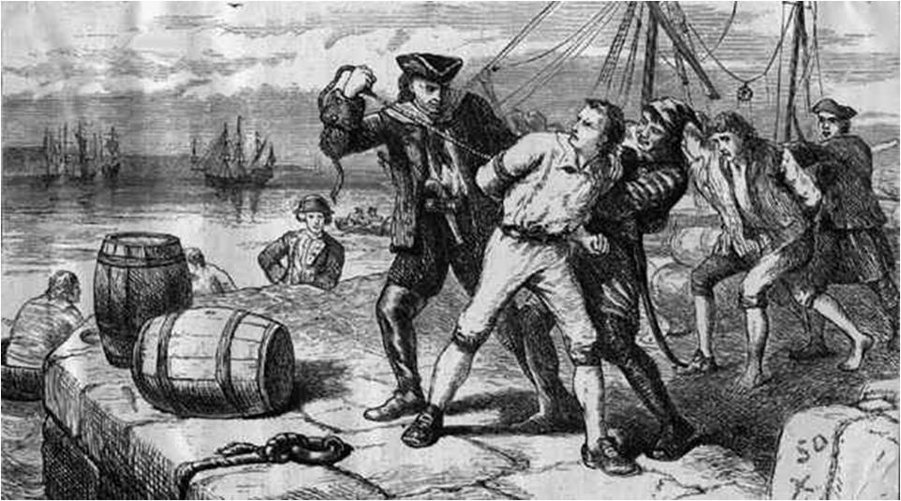
America’s Neutrality is Violated!
Both France (Berlin Decree) and England (Orders in Council) would confiscate US ships that traded with other country
To help fight Napoleon, Britain began using Impressment on US sailors
Forcing sailors to join the British Navy
Chesapeake-Leopold Affair
British ship (Leopold) attacks US ship (Chesapeake) while looking for alleged deserters
3 were killed, 18 injured

Slide 3
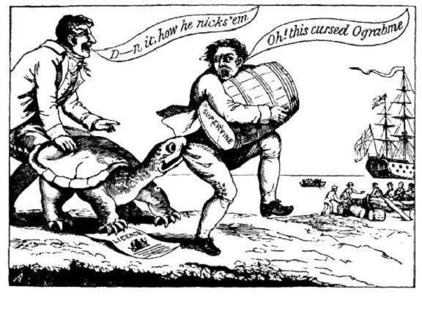
Embargoes to know
Embargo of 1807:
Passed in response to Chesapeake Incident
Forbade ALL US exports
Disaster!
Non-Intercourse Act: (1809)
Forbade exports to ONLY Britain and France
Still a disaster
Macon’s Bill #2: (1810)
Eventually agreed to restore trade with France

Slide 4
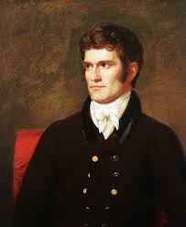
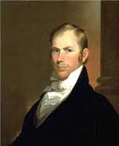
Why War with Britain?
War Hawks:
From South (SC) and West (KY)
John C. Calhoun and Henry Clay!
Democratic-Republicans (Jeffersonians) more biased towards France
British Impressments were well known

Slide 5

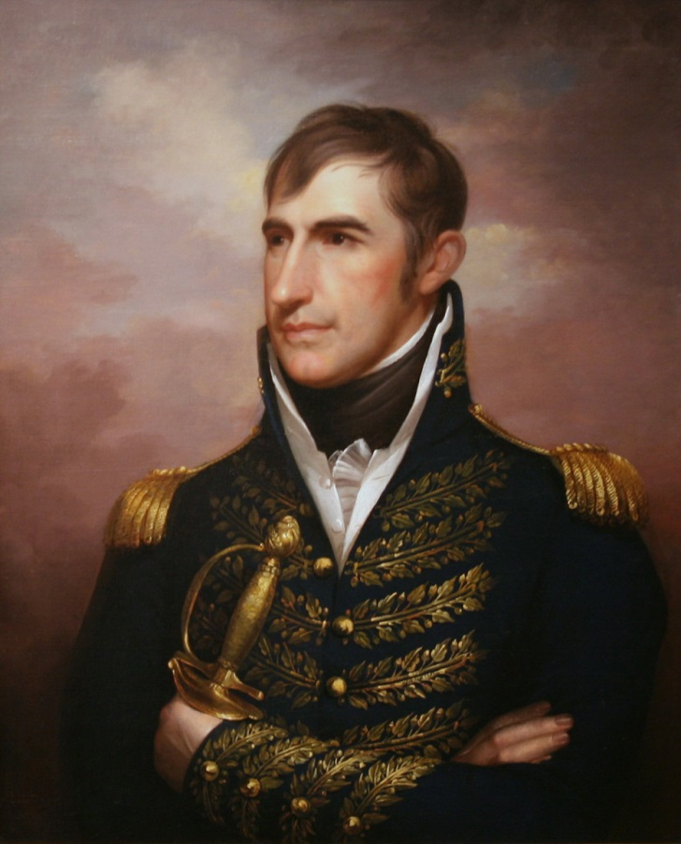
Key Battles and Events of the War
Battle of Tippecanoe (1811)
William Henry Harrison defeated Native Americans
Helped lead to further Westward expansion
Hartford Convention (1814 – 1815)
New England Federalists gathered to share grievances
Proposed amending Constitution:
1 term for president, 2/3 Congress to approve an embargo or declare war
Some delegates urged secession
Battle of New Orleans
Occurred two weeks AFTER war ended
US victorious, Andrew Jackson is an overnight sensation

Slide 6
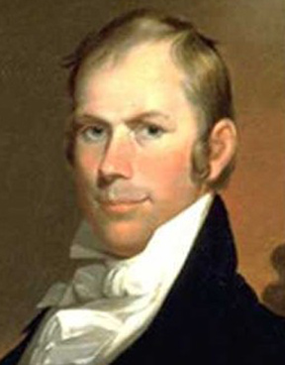
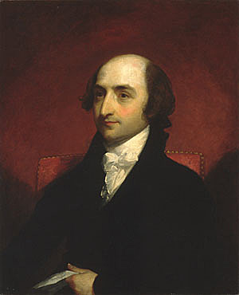
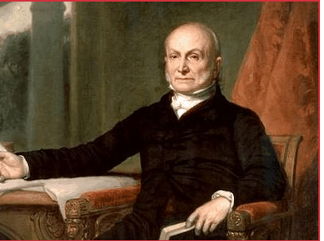
Treaty of Ghent
Signed on December 24, 1814
Agreement to stop fighting (Armistice)
Neither side gained territory
No mention of pre-war grievances

Slide 7
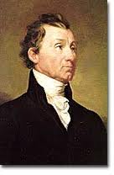
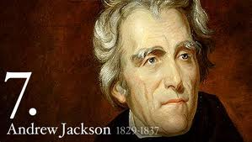
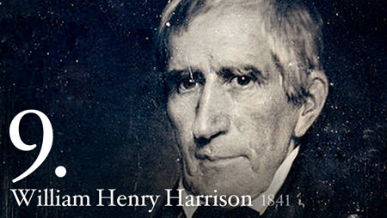
Impact of the War??
HUGE increase in Nationalism
Paved the way for future presidents
Jackson
Harrison
Demise of the Federalists
“Era of Good Feelings”

Slide 8
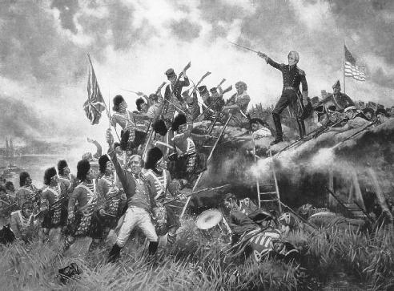
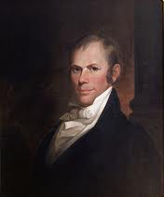
Please help
spread the word!

